Slide 1

Titanic Dataset AIML Assignment 1
Name: Dannon (P1922503)
Class: DIT/2A/14

Slide 2
Process
Data Importing
Exploratory Data Analysis
Data Preparation
Feature Selection
Training and Scoring models
Hyperparameter tuning

Slide 3
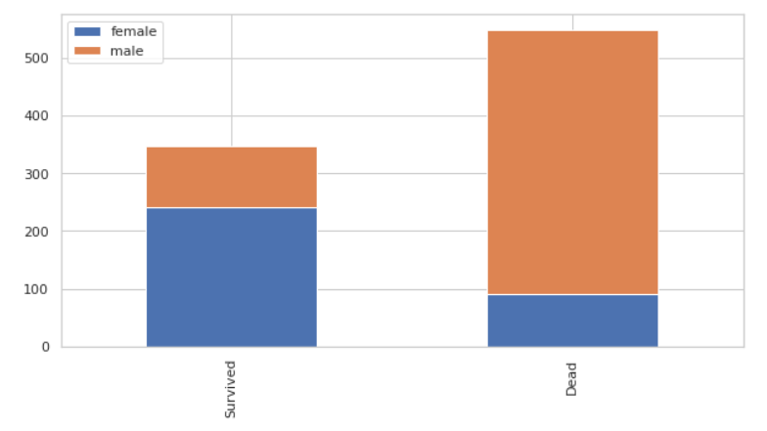
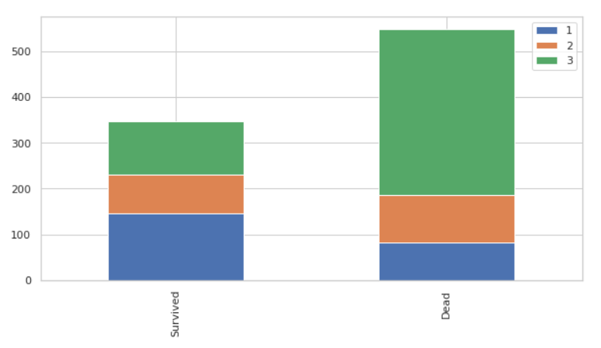
EDA
Fig 1
Fig 1 (Sex)
More males were on the titanic compared to females
Majority of females survived the titanic
Majority of males died
Fig 2 (Pclass)
Majority of passengers in 1st class survived
Majority of 2nd and 3rd class passengers died
Most of the deaths come from the 3rd class passengers
Fig 2

Slide 4
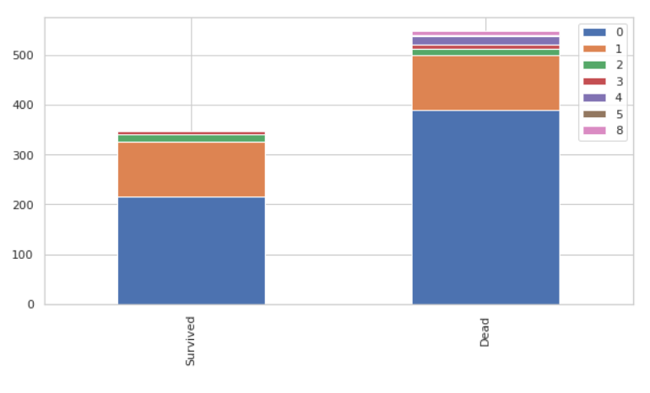
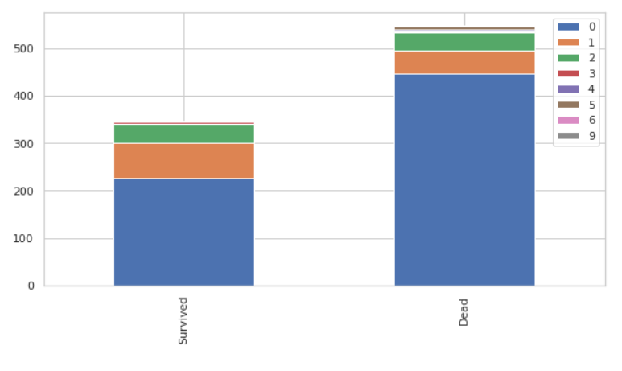
EDA
Fig 3
Fig 3 (SibSp)
Most passengers were on the titanic without siblings or spouses with them
Majority of those passengers died
Fig 4 (Parch)
Majority of passengers did not have their parents or children with them
Majority of passengers who died did not have their parents or children with them
Fig 4

Slide 5
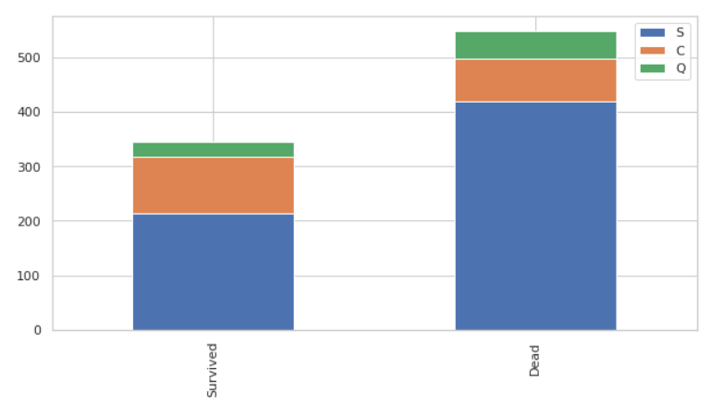
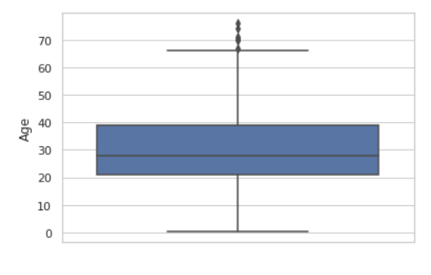
EDA
Fig 5
Fig 5 (Embarked)
Most passengers embarked from Southampton
Queenstown had the least amount of passengers
Majority of passengers who embarked from Cherbourg survived
Majority of passengers who died embarked from Southampton
Fig 6 (Age)
There are many outliers above the age of around 68
The median age is around 28
The first quartile is around 21 and the third quartile is around 39
Fig 6

Slide 6
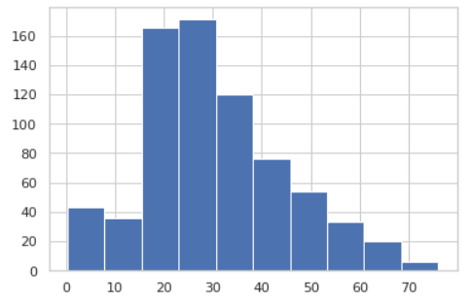
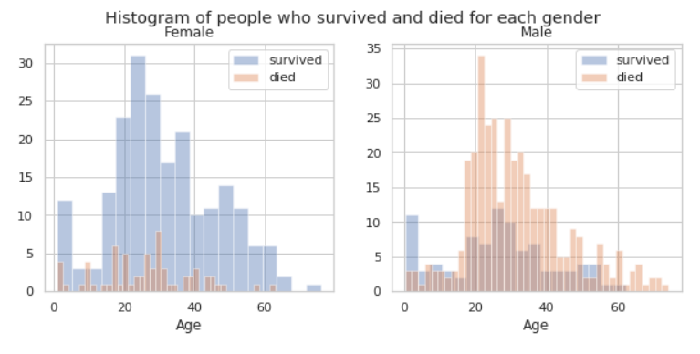
EDA
Fig 7
Fig 7 (Age)
The ages are positively skewed
Fig 8 (Age and Sex)
Majority of females survived the titanic and has a median age of around 25
Majority of males died during the titanic and had a median age of around 22
Majority of male and female children (around 0-4 years old) survived the titanic
Fig 8

Slide 7
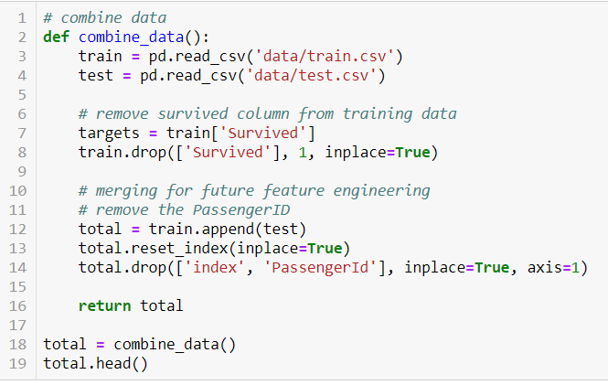
Feature Engineering
Combining datasets
train.csv and test.csv were appended together into total variable
The survive column in train.csv was assigned to target and dropped from the table
Combining was done to make it easier to feature engineer both datasets at the same time

Slide 8
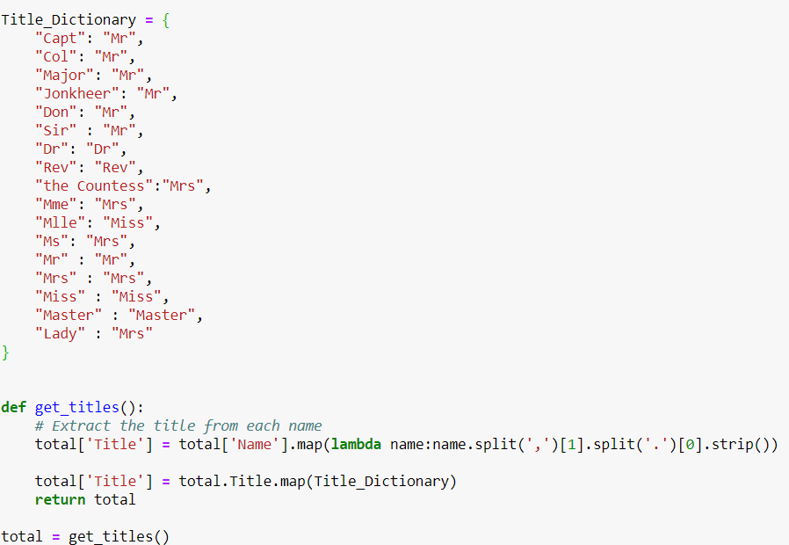
Feature Engineering
Passenger Titles
Passenger titles were extracted by splitting the names from the commas
A dictionary was created to assign each title to Mr, Miss, Mrs, Dr and Rev
A new column named ‘Title’ was created and the dictionary was mapped to the names with the respective titles

Slide 9
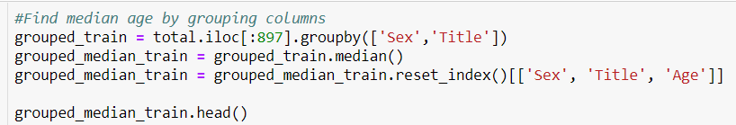
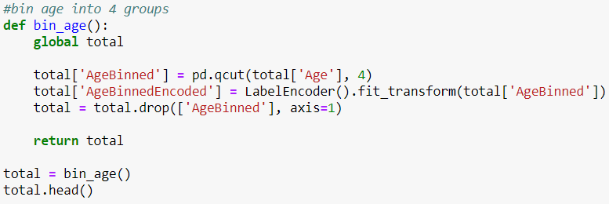
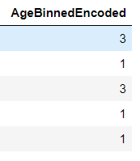
Feature Engineering
Passenger Age
The null value for age was filled in by using the median age of passengers grouped by their Sex and Title
The age is binned into 4 groups (Child, Young Adult, Adult, Elderly) using qcut

Slide 10
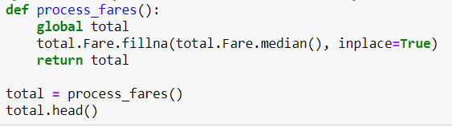
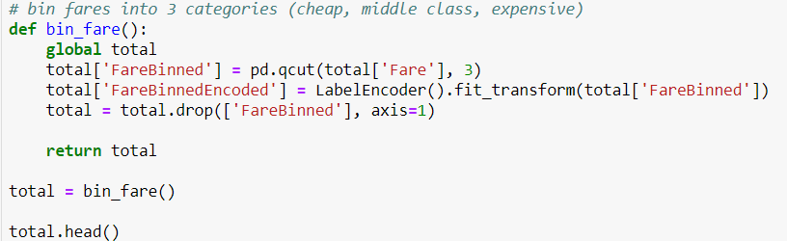
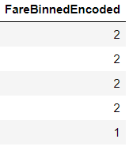
Feature Engineering
Passenger Fare
The null fare values were filled with the median fare value of the dataset
The fare column was binned into 3 groups (Cheap, Middle Class, Expensive) using qcut

Slide 11


Feature Engineering
Passenger Embarked
Null values of embarked were filled with the mode of embarked values in the dataset
Passenger Cabin
Null values of Cabin were replaced with ‘No’ and the remaining values were replaced with ‘Yes’
Passenger Family
A new column named ‘FamilySize’ was created by adding the number of parents, children, sibling and spouse the passenger had with himself

Slide 12
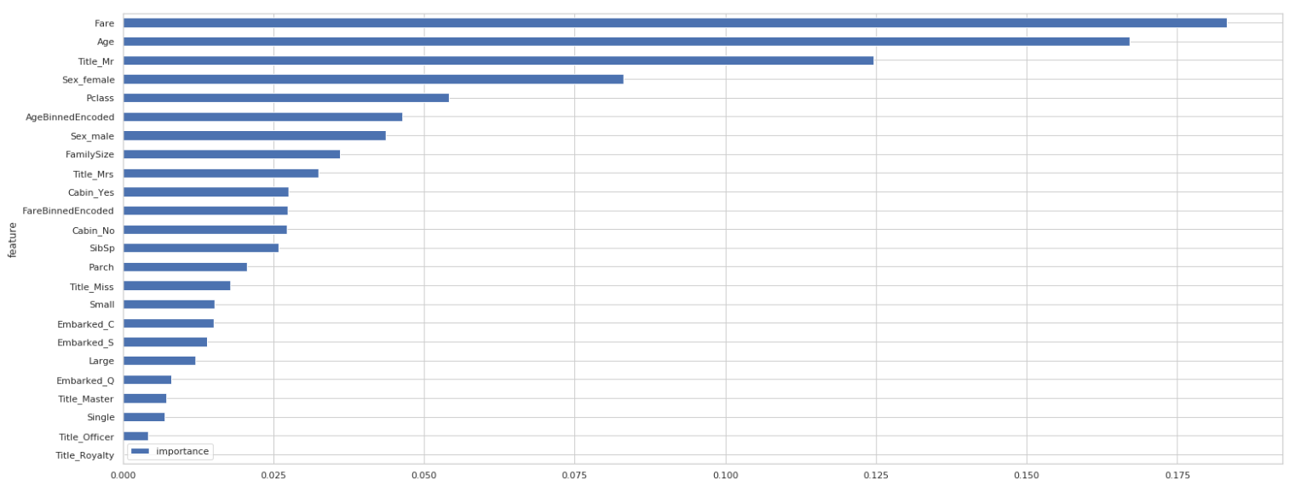
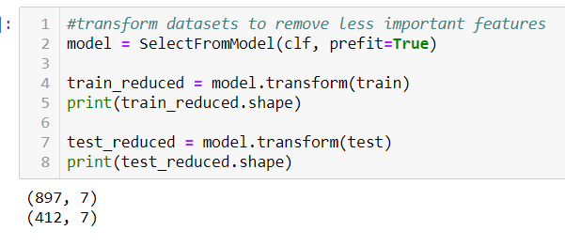
Feature Selection
Trained Random Forest Classifier to identify the most important features
Created new dataset containing the most important features
Used feature_importances_ to get features
Sorted features
Plotted horizontal bar
Fare, Age, Title_Mr, Sex_Male, Sex_Female, Pclass, FamilySize, were chosen to be in the new dataset

Slide 13

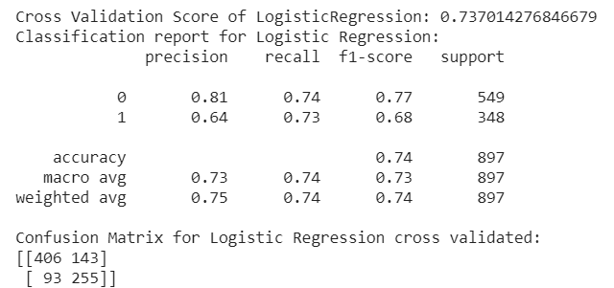
Scoring Models
Logistic Regression
Created a function to calculate the mean cross validation score of the models
Cross validation score is 0.737
Used cross_val_predict to get the classification report and confusion matrix
The model correctly predicted 406 deaths and 255 survivors and wrongly predicted 143 deaths as survivors and 93 survivors as dead

Slide 14
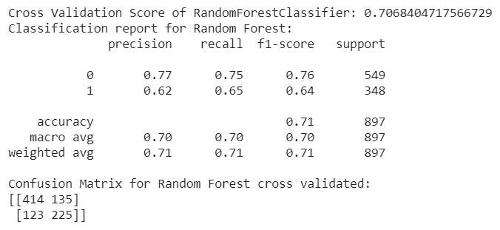
Scoring Models
Random Forest
Cross validation score is 0.707
Used cross_val_predict to get the classification report and confusion matrix
The model correctly predicted 414 deaths and 255 survivors and wrongly predicted 135 deaths as survivors and 123 survivors as dead

Slide 15
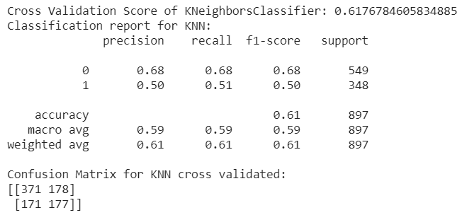
Scoring Models
K Nearest Neighbours
Cross validation score is 0.618
Used cross_val_predict to get the classification report and confusion matrix
The model correctly predicted 371 deaths and 177 survivors and wrongly predicted 178 deaths as survivors and 171 survivors as dead

Slide 16
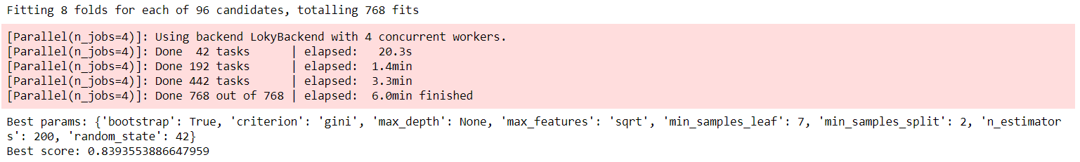

Tuning Hyperparameters
Used GridSearchCv
Used Stratified K Fold to shuffle and split data into 8 folds
Conduct the grid search with the data
Random Forest has a best score of 0.839
Logistic Regression has a best score of 0.761
KNN has a best score of 0.638

Slide 17
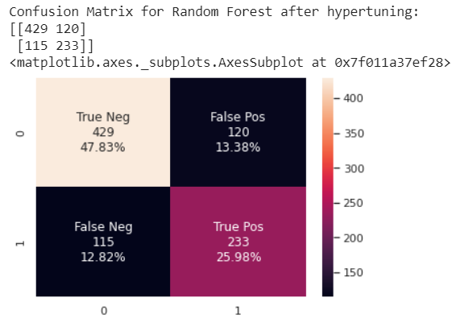
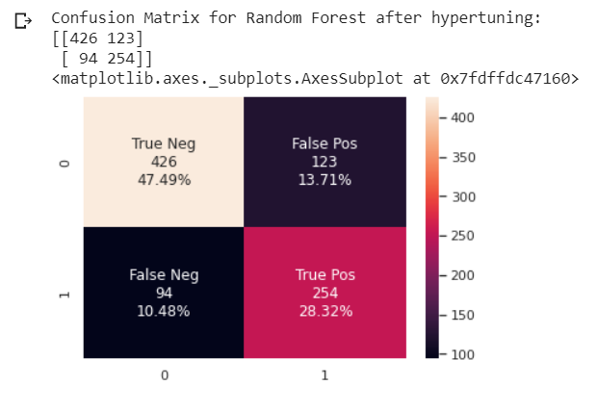
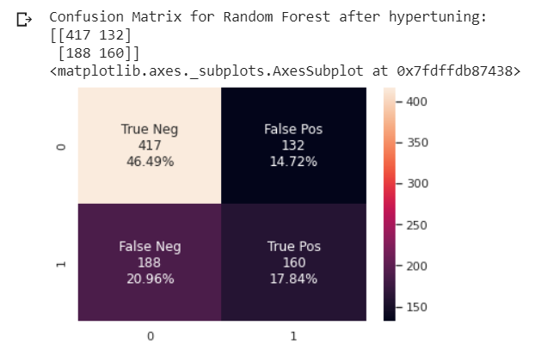
Confusion Matrix
The Random Forest model correctly predicted 429 deaths and 233 survivors, and wrongly predicted 120 deaths as survivors and 115 survivors as dead
The Logistic Regression model correctly predicted 426 deaths and 254 survivors, and wrongly predicted 123 deaths as survivors and 94 survivors as dead
The KNN model correctly predicted 417 deaths and 160 survivors, and wrongly predicted 132 deaths as survivors and 188 survivors as dead

Slide 18
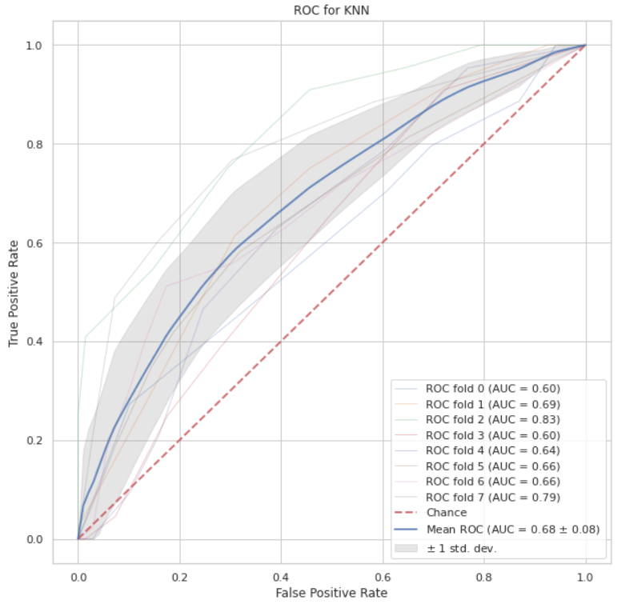
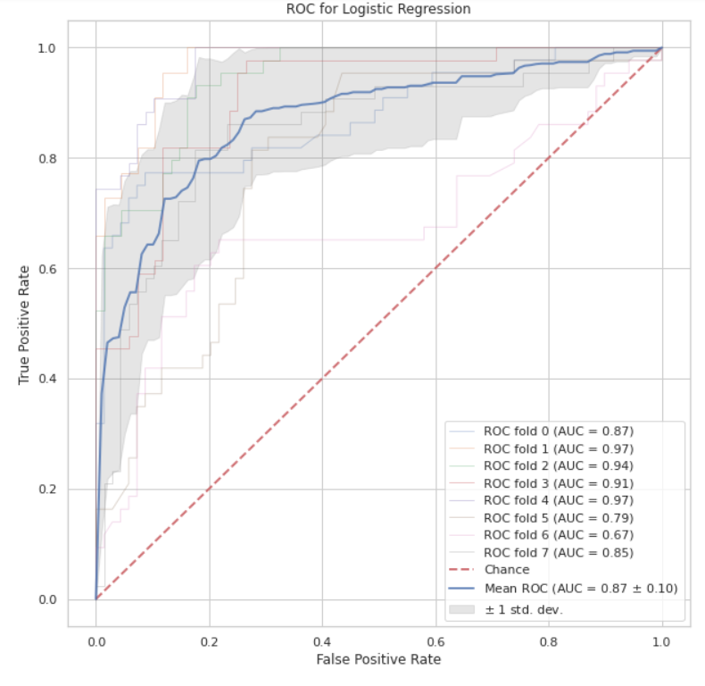
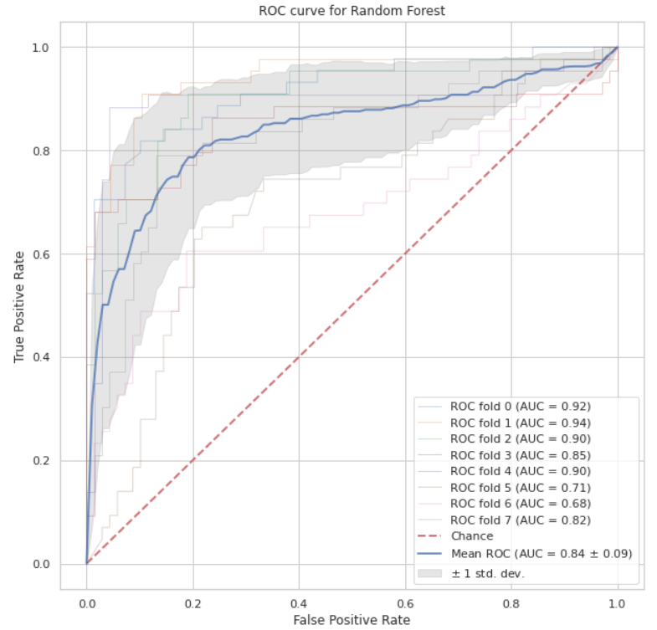
ROC Curve
KNN
The Random Forest has a mean Area Under the Curve of 0.84 +- 0.09
The Logistic Regression has a mean Area Under the Curve of 0.87 +- 0.10
The KNN has a mean Area Under the Curve of 0.68 +- 0.08

Slide 19
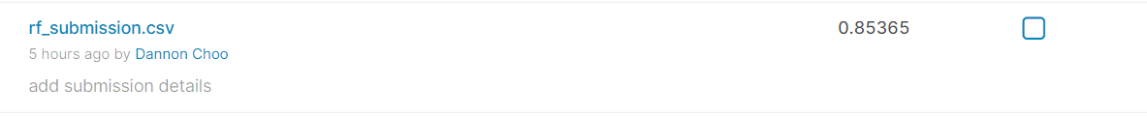

Submitting to Kaggle
The models were used to predict the survival of the passengers in test.csv and the output was submitted to Kaggle
Random Forest scored 0.85365, Logistic Regression scored 0.81300 and K Nearest Neighbours scored 0.70731
The Random Forest model performed the best out of all 3 classifiers while KNN performed the worst

Slide 20
Conclusions
Even though the Random Forest Classifier did not perform as well as the Logistic Regression Classifier, it managed to score better on both train.csv and test.csv after tuning hyperparameters
The Fare, Age, Gender, Pclass and Mr_title are the top features for Random Forest
Tuning the hyperparameters of a classifier can significantly improve its accuracy
Feature Importance is useful for finding the most important features for a model. It reduces overfitting and training time of the model as there is less redundant data

